Slide 1
Suicide Prevention, Self-Care, and Coping Skills
Texans Recovering Together Crisis Counseling Program
Erath, Hood, Johnson, Palo Pinto, Parker, and Somervell Counties
Notes:
Shelley

Slide 2
Texas Statistics
3928 people died in Texas by suicide in the year 2018
Highest rate of suicide is in middle age, and older white men
On average, there are 11 suicides per day
Texas Health and Human Services
Notes:
Shelley

Slide 3
Risk Factors
A risk factor
Characteristics that increases the chance that someone may attempt suicide
One way to understand suicide prevention is by understanding the risk factors, warning signs, and the protective factors.
Texas Health and Human Services
Notes:
Shelley

Slide 4
Risk Factors
Suicide of a loved one
Divorce/Separation
Legal problems/arrest
Victim of crime or abuse
Witness to violence
Loss of job
Financial problems
Chronic illness/pain
Lack of social support
Use of alcohol or other substances
History of, or current mental illness
Feelings of being a burden
Previous attempt (s)
History of trauma
Texas Health and Human Services
Notes:
Shelley

Slide 5
Warning Signs
Warning signs are indicators that an individual may be in acute danger and needs help immediately.
Texas Health and Human Services
Notes:
Erin

Slide 6
Warning Signs
Loss of interest in activities
Verbally talking about suicide
Decreased social interaction, self care, and grooming
Feeling hopeless and or worthless
Putting affairs in order, giving things away, or making changes in will
Stock piling medication
Dramatic changes in mood
Texas Health and Human Services
Notes:
Erin: When you start to notice a friend, family member, girlfriend/boyfriend, or anyone that you know showing any of these signs, they may be in serious danger and will need help ASAP.

Slide 7
Protective Factor
What is a protective factor?
Characteristics, traits, or supports that make an individual less likely to attempt suicide
Texas Health and Human Services
Notes:
Erin

Slide 8
Protective Factors
Access to mental health treatment
Family support
Community support
Healthy Coping Strategies
Sense of purpose
Hope for the future
Protection from lethal means
Having sense of responsibility for others
Texas Health and Human Services
Notes:
Erin: A protective factor is a something that helps an individual to make them less likely to attempt suicide.

Slide 9
What To Do??
If you know someone who is showing signs of suicide here is what you should do:
Ask them if they have thoughts or a plan
Listen to them and be non- judgmental
Let them know that you care
Believe what they say (take their words seriously)
Offer hope
Get help (stay with them until they receive help)
Texas Health and Human Services
Notes:
Callie Ann

Slide 10
Stress and Suicide
High levels of stress and anxiety can lead to depression, and when untreated can lead to serious mental health concerns and even suicide.
To manage these high levels of stress, healthy coping skills and self-care is important in your everyday lives.
Notes:
Callie Ann

Slide 11
Signs of Stress
Rapid heartrate
Strong Negative feelings
Unable to think clearly
Strong emotional reactions
Changes in body (stomach aches, headaches, etc.)
Changes in your sleep
Dangerous behavior
Strong emotional reactions
(Texas Department of Health and Human Services, 2020)
Notes:
Callie Ann

Slide 12
Tips for Managing Stress
1.Know your normal reactions
2.Know your body
3.Exercise and eat healthy
4.Recognize your own reactions to stress
5.Connect to support in your community
6.Use time off to relax
7.Practice healthy coping skills
8.Practice self care
(Texas Department of Health and Human Services, 2020)
Notes:
Andrea

Slide 13
Coping Skills
What are coping skills?
Strategies and techniques people often use in times of stress to manage difficult emotions (Good Therapy, 2018)
Healthy VS Unhealthy Coping Mechanisms (Ghaffari, 2020)
Healthy coping skills are ways to cope with your stress or difficult emotions that support you in reaching a point of healing, resilience, and positive growth.
Unhealthy coping skills are maladaptive ways to cope with stress or difficult emotions that can increase a problem or cause more distress in the long run.
Notes:
Andrea

Slide 14
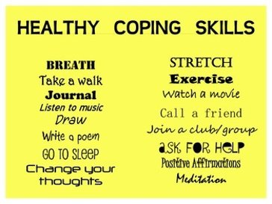
Healthy Coping Skills
Take care of your body
Maintain a routine
Talk to people you feel comfortable with about your feelings and worries
Engage in physical activity
Do hobbies or activities that you enjoy, calm you down or focus your mind and body
If you continue to feel overwhelmed, out of control or unable to calm down after a period of weeks, seek help from a mental health professional
(Mental Health First Aid USA, 2020)
Teachers Pay Teachers. (n.d.). Coping skills poster. [Image]. Retrieved from https://www.teacherspayteachers.com/Product/Coping-Skills-Poster-1201114
Notes:
Andrea

Slide 15
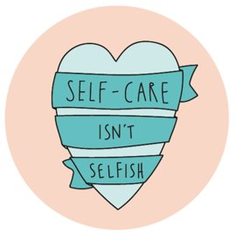
Self-Care
Practicing self-care is a great way to manage your stress
Here are some ways to manage self-care
Watch your favorite show
Play with your pet
Draw
Cook with a guardian
Talk to a friend or trusted adult
Hang out with a friend
Play video games
Practice your favorite sport
Schedule time every day to do something for YOU
Her Campus. (2018). Self-care. [Image]. Retrieved from https://www.hercampus.com/school/simmons/self-care
Notes:
Andrea

Slide 16
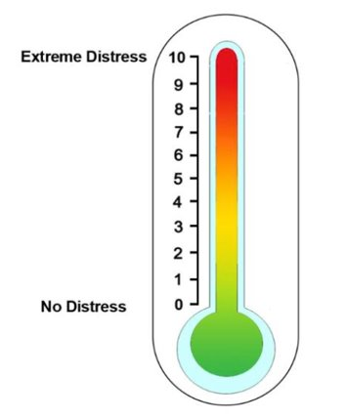
Distress Thermometer
This is a tool to measure distress
If you are in the orange or red, this means that you are in high distress and may need to take some time to reset and practice good coping skills or self-care.
If you are in the yellow, this would be a good time to recognize that you may be in high distress soon and by practicing healthy coping skills and self-care it can help bring you back down to green.
If you are in green, keep up the good work! You are practicing good self-care and coping skills!
Notes:
Andrea

Slide 17
Numbers to Know:
National Suicide Prevention Lifeline: ​
1-800-273-TALK (8255)​
24/7 Pecan Valley Crisis Hotline: ​
1-800-772-5987​
24/7 Crisis text line: ​
Text "TX" to 741741​
Trevor Project (LGBTQ Young People): ​
1-866-488-7386
Notes:
Callie Ann

Slide 18
References
Texas Department of Health and Human Services. (2020). Managing your stress [PDF]. Retrieved from https://hhs.texas.gov/sites/default/files/documents/services/mental-health-substance-use/public-tips-managing-your-stress.pdf
Texas Health and Human Services
http://clipart-library.com/texas-cliparts.html
Notes:
Callie Ann

